Slide 1
Space Invaders : A Multi-Player Space Game
Team Members:
Atul Tiwari (THA079BEI006)
Prabal Koirala (THA079BEI019)
Prasan Gautam (THA079BEI022)
Prashant Bhusal (THA079BEI024)
Supervised By:
Er. Saroj Sakya
Department of Electronics and Computer Engineering Institute of Engineering, Thapathali Campus
February 2024

Slide 2
Presentation Outline
Introduction
Motivation
Objectives
Methodology
Scope of Project
How To Play
Results
Future Enhancements
Reference

Slide 3
Introduction
A two-player engaging and competitive game to play between friends.
Use of different OOP concepts
Uses SFML library for the game development

Slide 4

Motivation

Slide 5
Objectives
To develop a two-player game that offers a blend of competition, strategy, and engaging gameplay.
To reinvent a classic arcade game

Slide 6
Scope of Project
Project Capabilities
We can access two spaceships. One using the W, A, S, D and another using the up, down, left and right arrows.
Shoot bullets to destroy the incoming asteroids
Project Limitations
Couldn’t implement networking to make it actually multiplayer
Not much obstacles to have retaining players

Slide 7
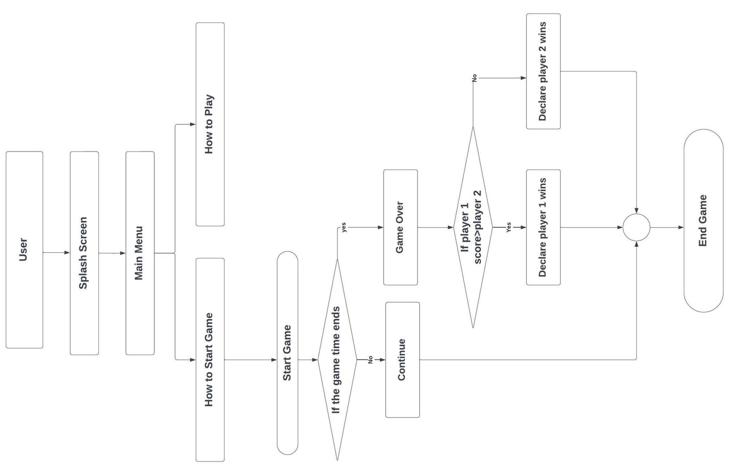
Methodology-[I] (System Block Diagram)

Slide 8
Methodology-[2]
Continuously updates game state, handles user input, and refreshes display.
Use of OOP to manage players, asteroids, bullets, and game environment.
Utilize SFML to render and update game visuals within the loop.
Identify interactions between game entities for accurate gameplay.

Slide 9
How To Play
Player 1 Spaceship is controlled using the arrow keys.
Player 2 Spaceship is controlled using the A,S,D and W keys
Player 1 can shoot asteroids using “Space” key
Player 2 can shoot asteroids using “F” key

Slide 10
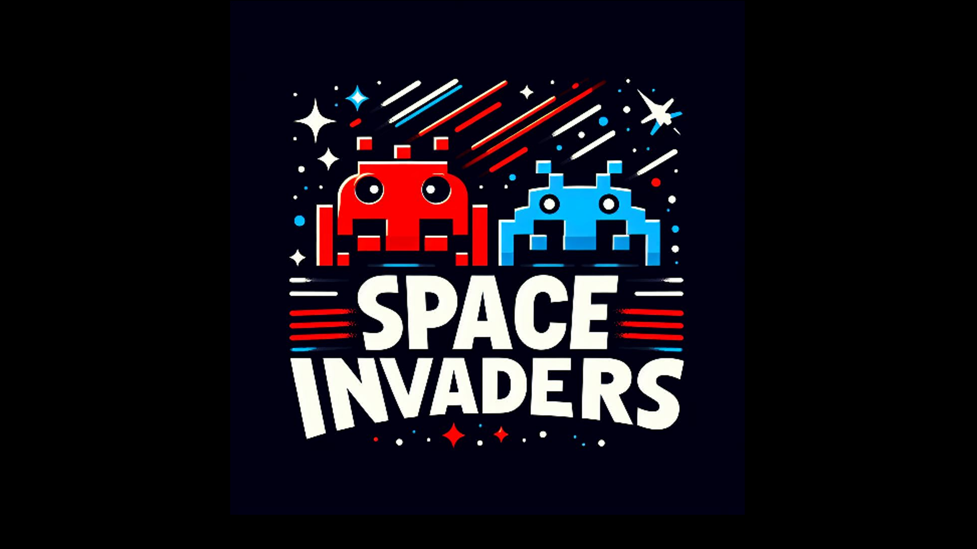
Result - [1] (Splash Screen)

Slide 11
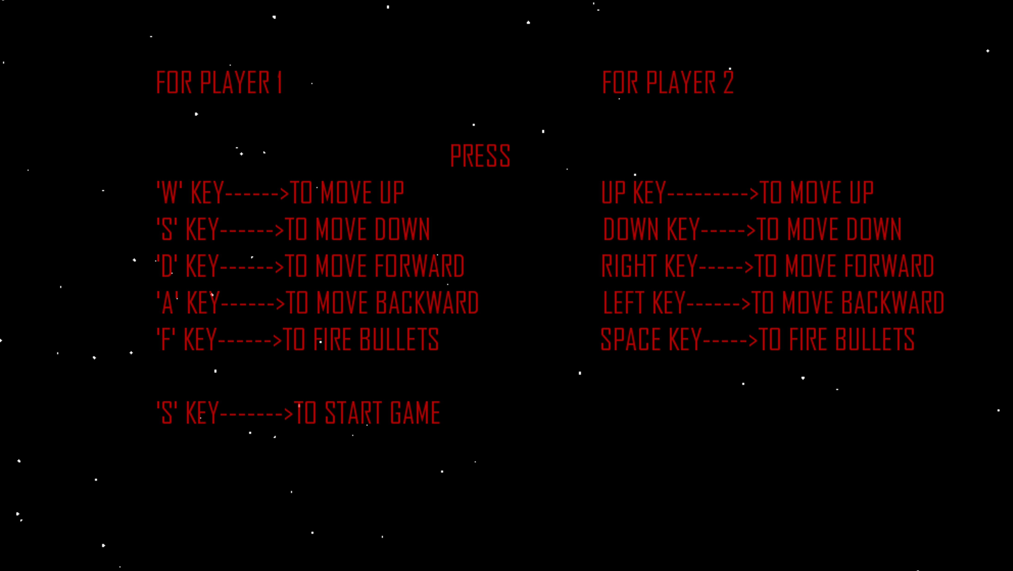
Result - [2] Menu

Slide 12
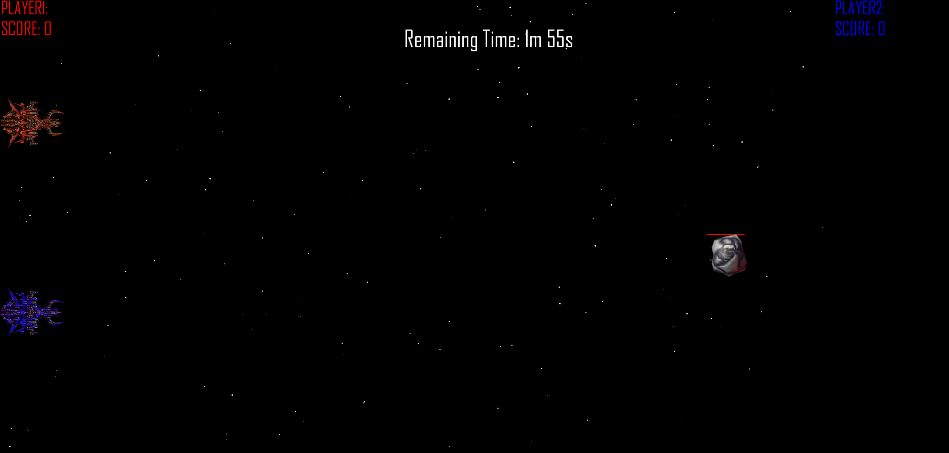
Result - [3] (Game Screen)

Slide 13
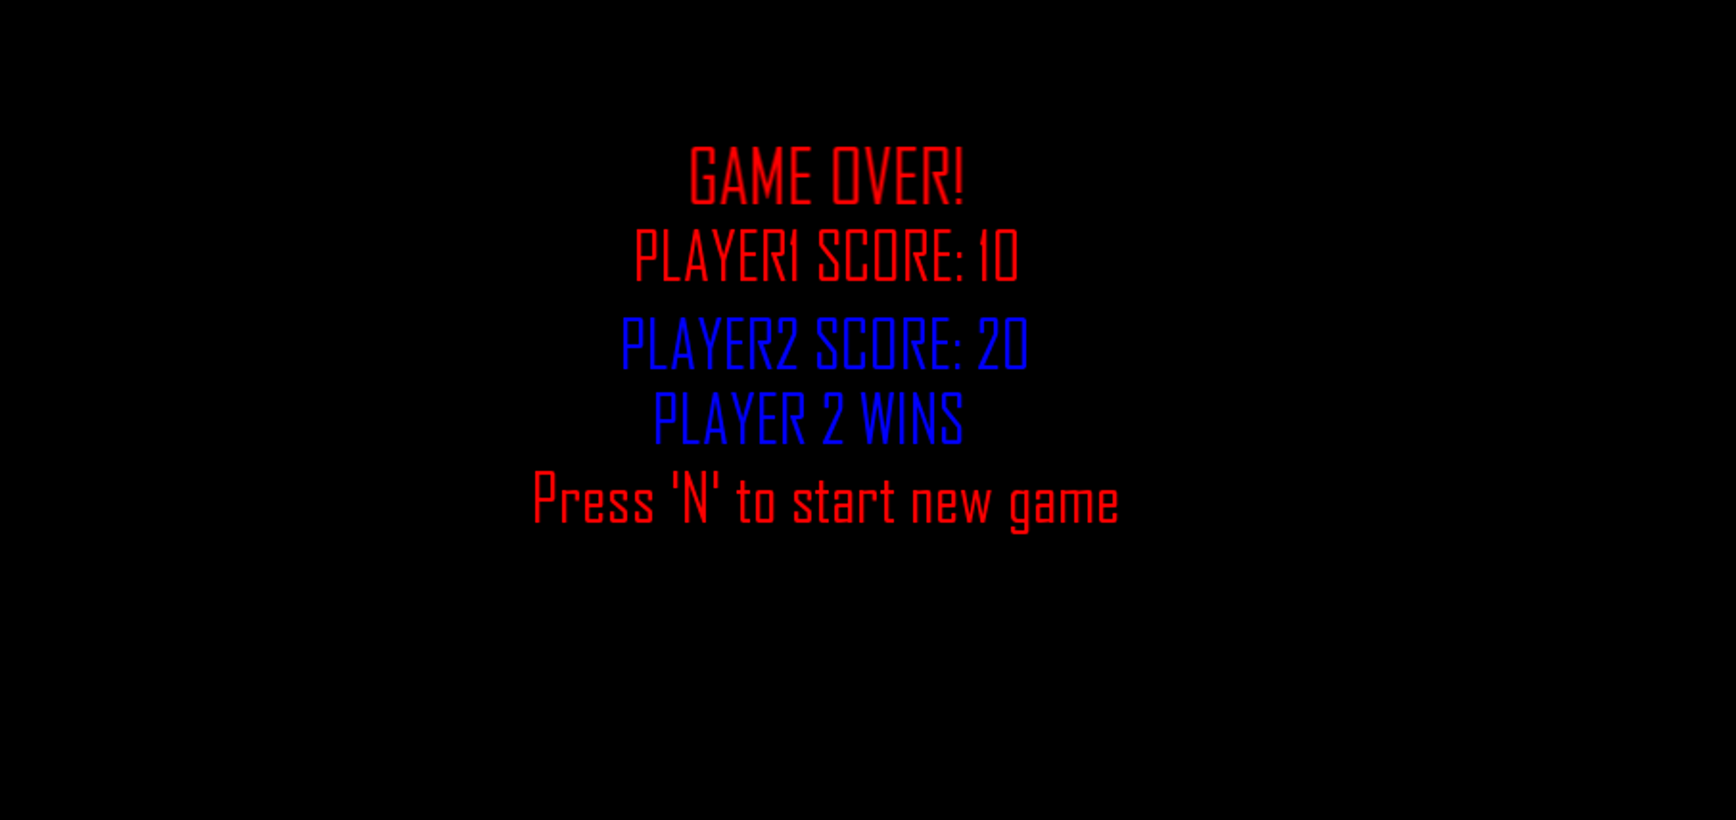
Result - [4] (Game Over Screen)

Slide 14
Future Enhancement
Online Multiplayer Mode
Enhanced Graphics and Visual Effects
Additional Power-Ups and Abilities
Dynamic Environments and Obstacles

Slide 15
References-[1]
[1] Wikipedia Contributors, “Space Invaders,” Wikipedia, Apr. 16, 2019. https://en.wikipedia.org/wiki/Space_Invaders
[2] “2.6 Tutorials (SFML / Learn),” www.sfml-dev.org. https://www.sfml-dev.org/tutorials/2.6/
‌[3] “SFML — Simple and Fast Multimedia Library,” GitHub, Dec. 15, 2022. https://github.com/SFML/SFML

Slide 16
References-[2]
[4] Raimondas Pupius, SFML game development by example : create and develop exciting games from start to finish using SFML. Birmingham, Uk: Packt Publishing, 2015.
[5] “SFML C++ Tutorial 12 (PART 1/4) | 2D Space shooter game using Sprites, Textures and UI with Text,” www.youtube.com. https://www.youtube.com/watch?v=sWYpNIrBr6U&t=10s

